Slide 1


Introduction to WEDO 2.0
By Sanjay and Arvind Seshan

Slide 2
About Wedo
What is WEDO?
WEDO is a simple programmable brick that is intended for education purposes.
Your kit comes with the following electronics:
Move Hub
1 Motor
1 Motion/Tilt Sensor
You will need batteries to power the Wedo

Slide 3
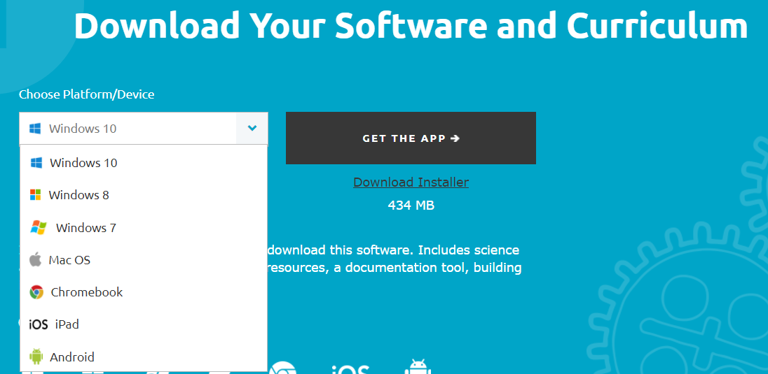
Installing the Software
The WEDO supports Android, iOS, Mac, PC, Chromebook
To download the app, click on the links below:
Android: https://play.google.com/store/apps/details?id=com.lego.education.wedo&hl=en
iOS: https://itunes.apple.com/au/app/lego-education-wedo-2.0-full/id1011085891?mt=8
Chromebook: https://chrome.google.com/webstore/detail/wedo-20/pflionopdgpjckjkafnlamfmonjhccdh?utm_source=gmail
Mac/PC: https://education.lego.com/en-us/downloads/wedo-2
Once you open the app, accept the disclaimer.

Slide 4
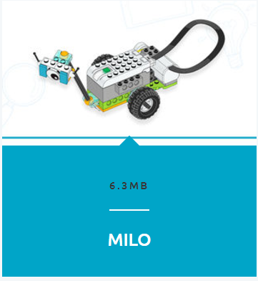
Build your Robot
Start by building the “MILO”
The App contains the Build Instructions for each of the models.
Alternatively, you can use the PDF instructions available here: https://education.lego.com/en-us/support/wedo-2/building-instructions
Image Credit: LEGO

Slide 5
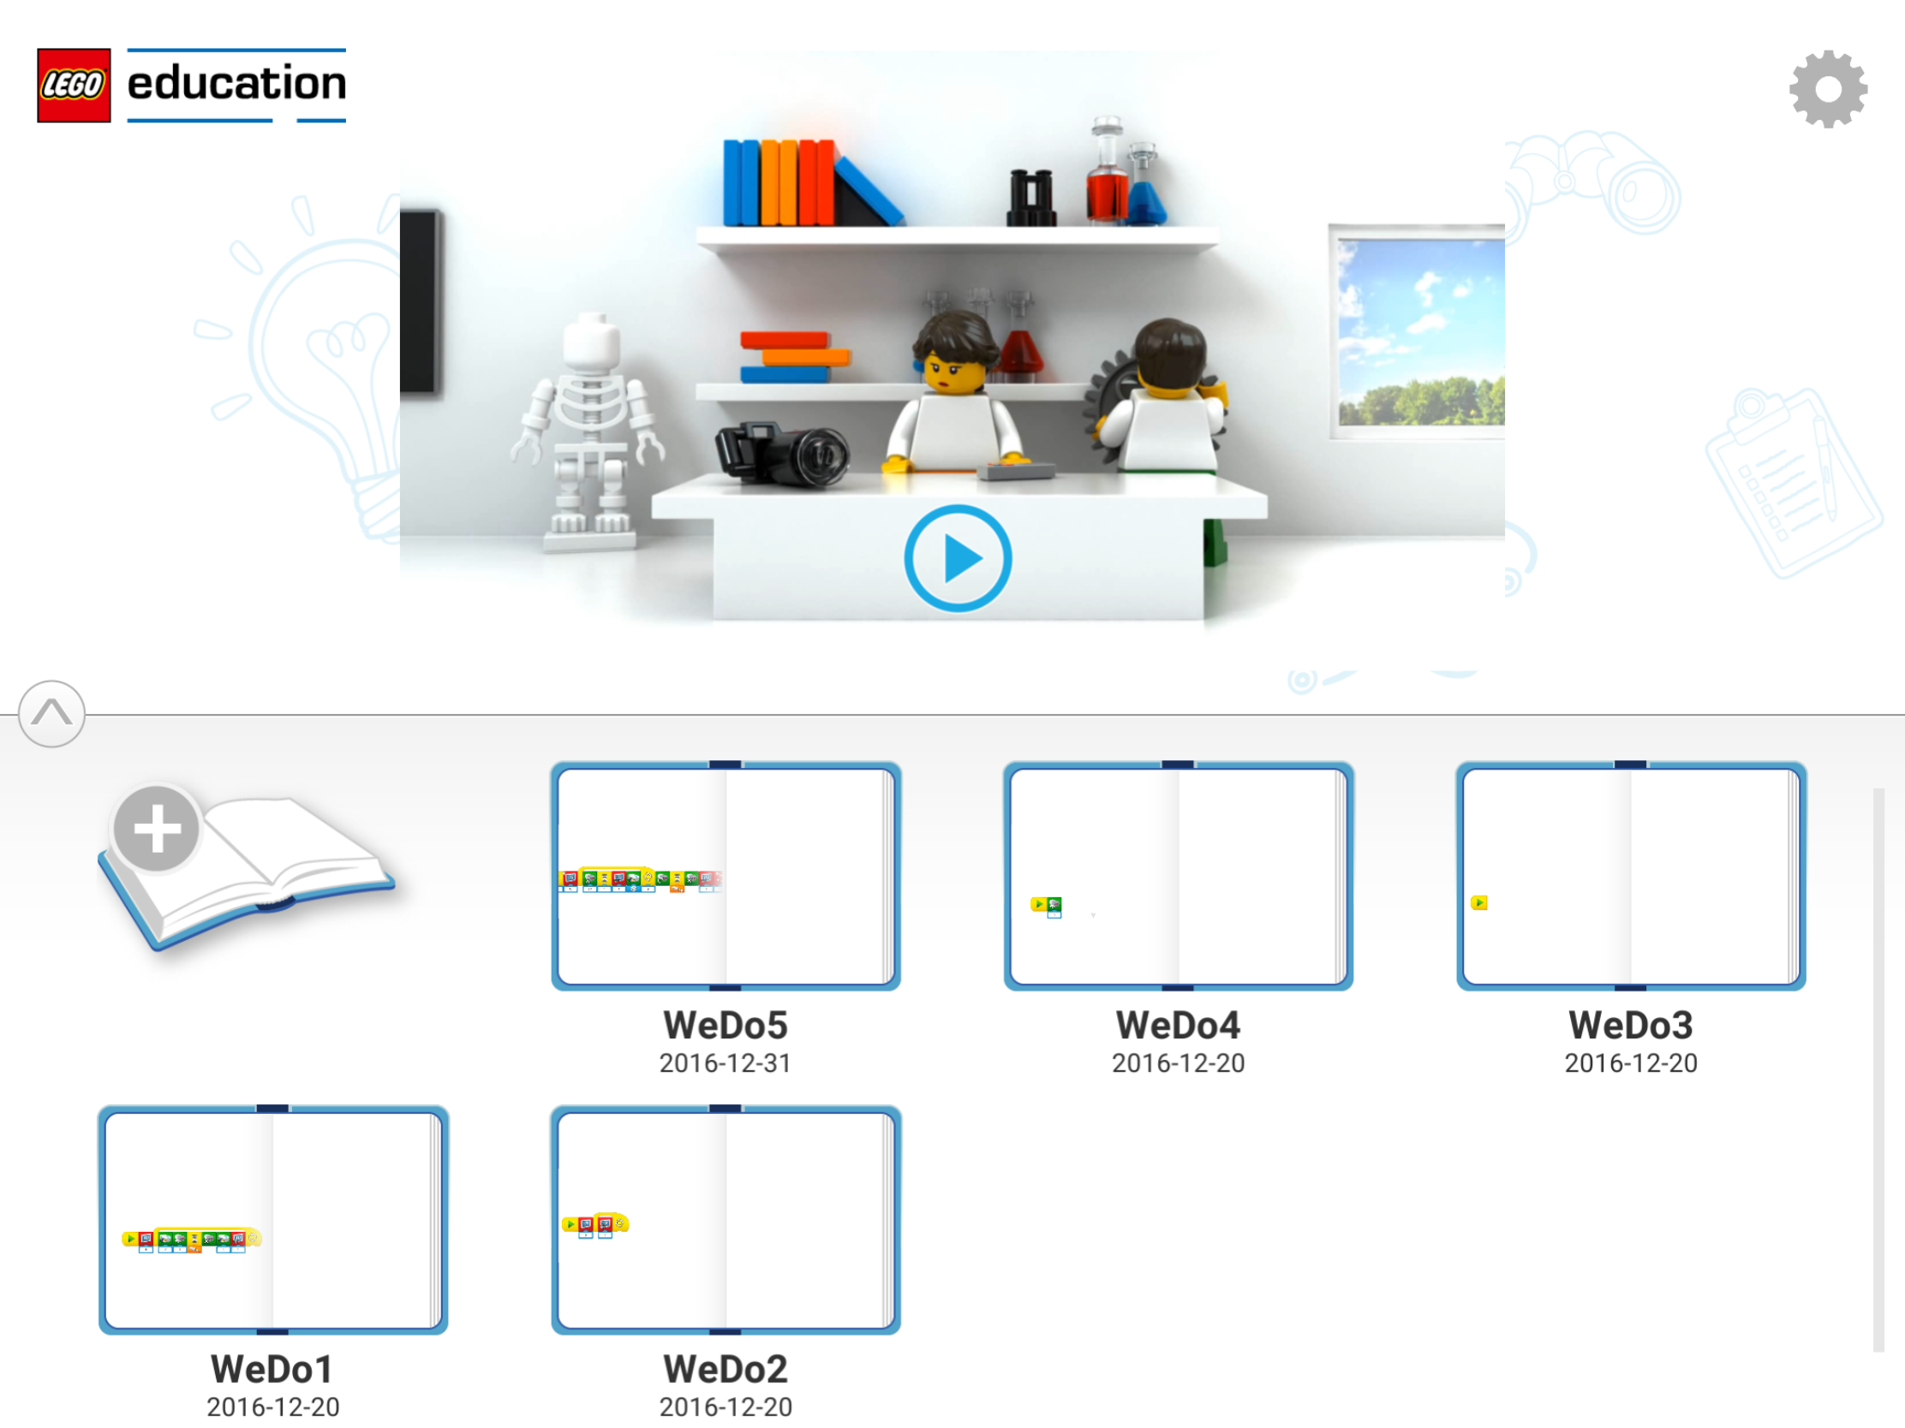
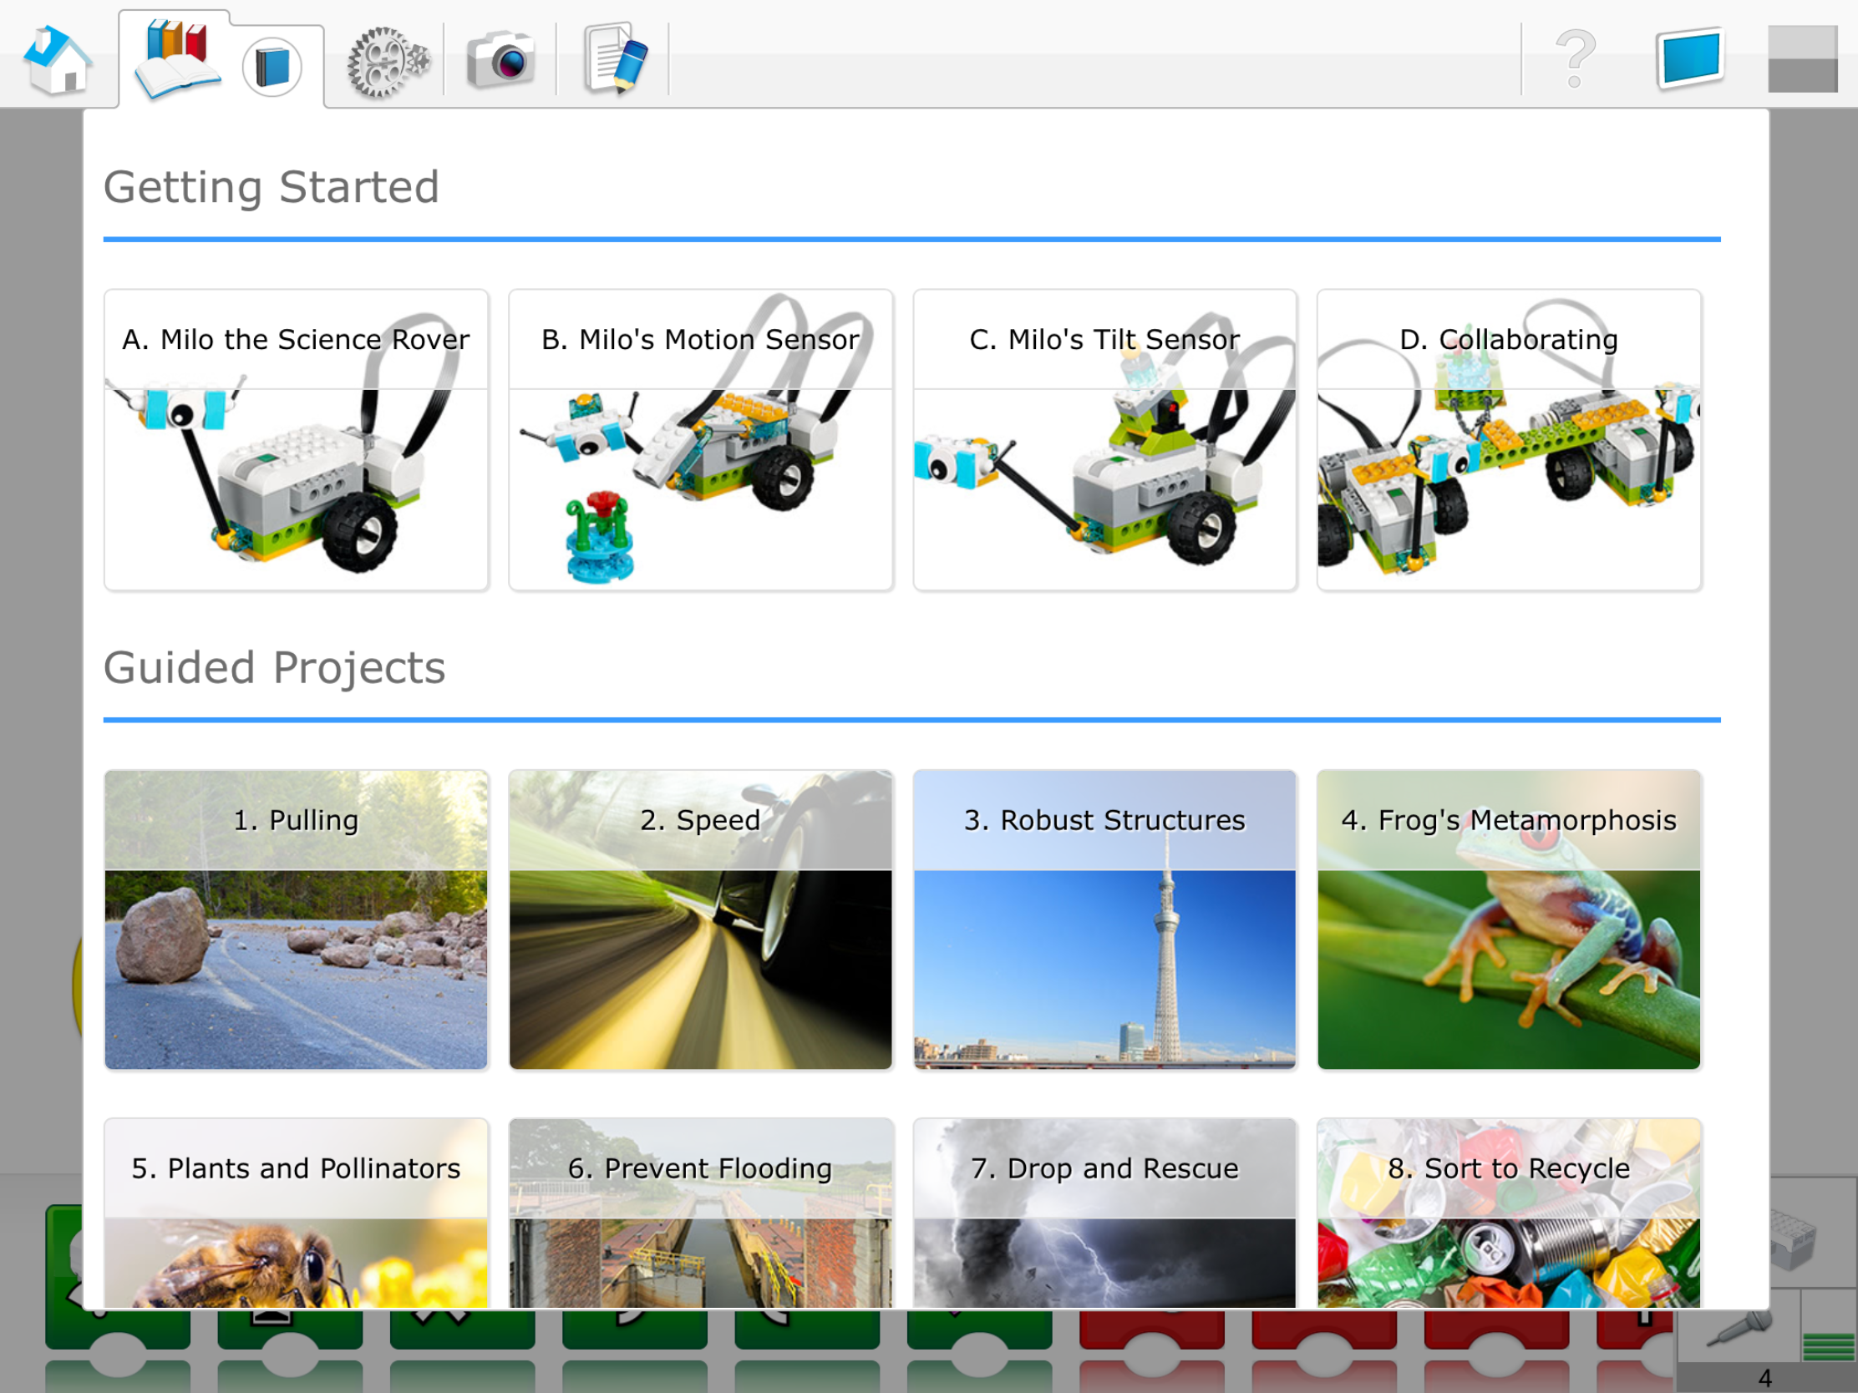
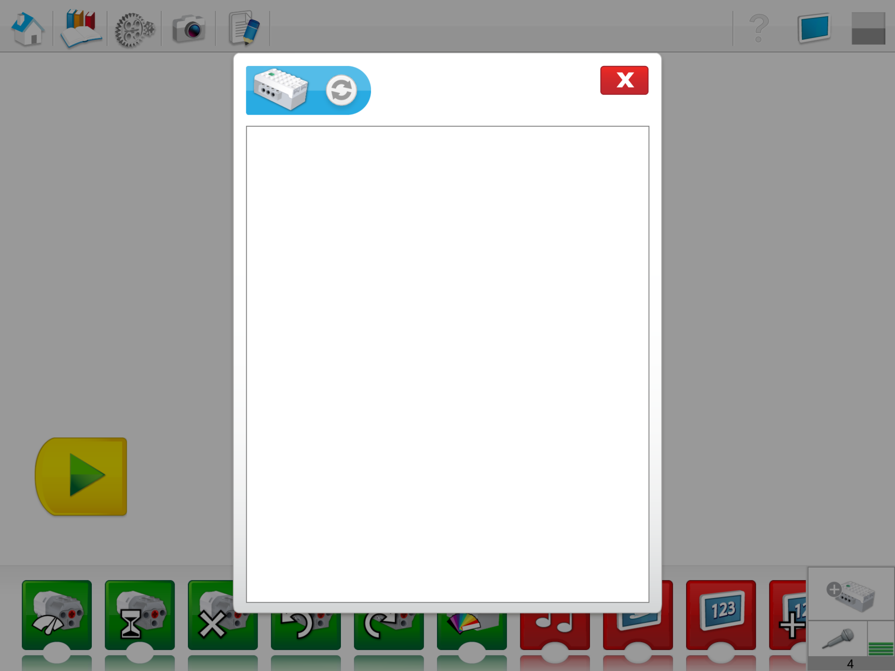
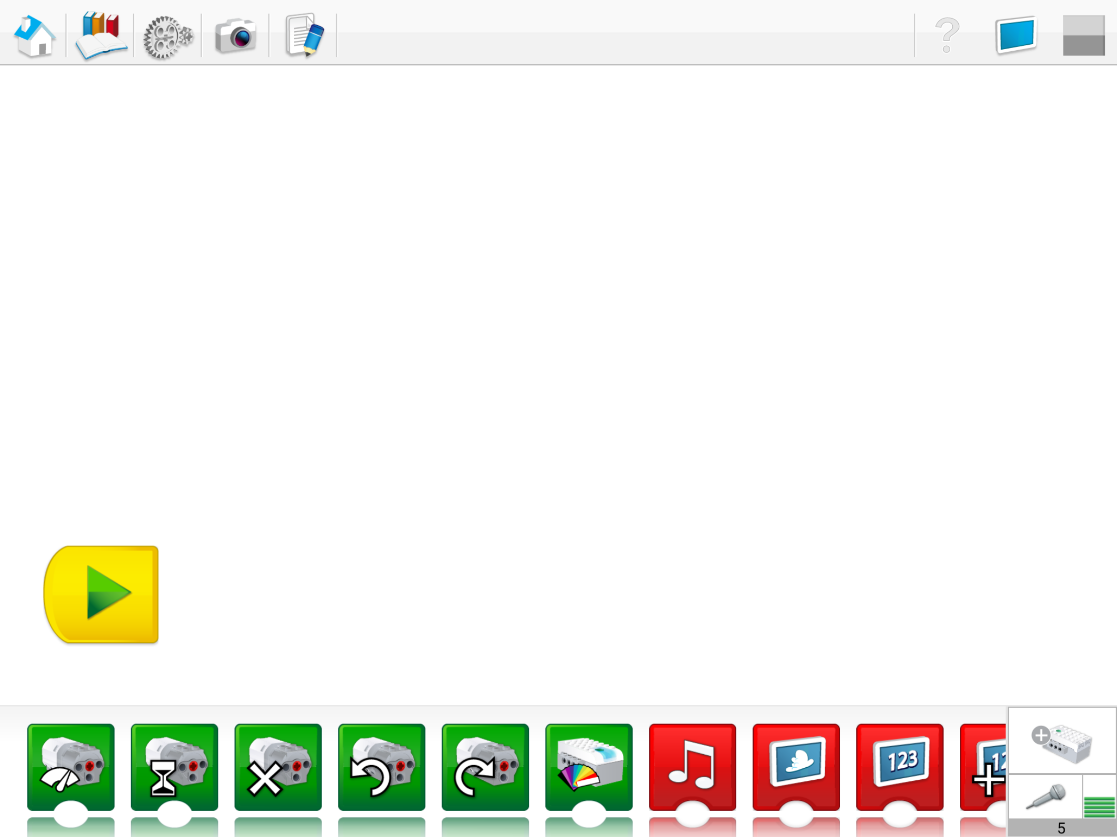
Connect to your WEDO
Click on new program
Exit the menu
Press the green button on the hub and choose your device onscreen.
Click on add a WEDO

Slide 6
Now you are ready to start programming!

Slide 7
Credits
Lesson by Sanjay and Arvind Seshan
This work is licensed under a Creative Commons Attribution-NonCommercial-ShareAlike 4.0 International License.
Photo Credits: LEGO, Screenshots taken from the LEGO Education WEDO App

